Slide 1
Music Management
By-
Group 30
2019BCS-040
2019BCS-079

Slide 2
Main Features of Project:
The project is designed for a music store.
It can help in create order, find music , add new Item , remove Item and to keep record of items in stock.
It uses basic concepts of oops to create objects and functions to perform different functions.

Slide 3
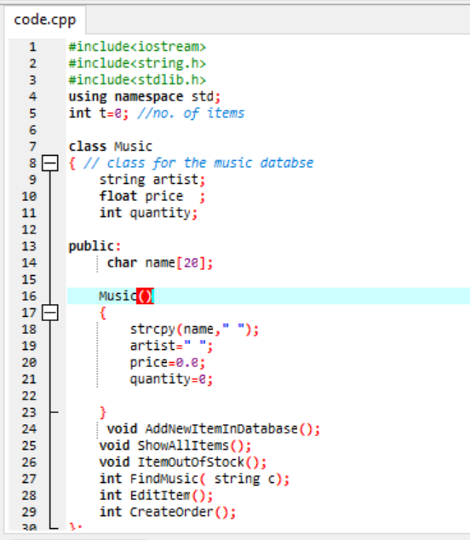
Class Music
This is the class music in which we have declared four private members and some other public members.
Public Members include member functions and a non-parameterized constructor music.
The member functions are:-
Add New Item In Database
Show All Items
Item Out Of Stock
Find Music
Edit Item
Create Order

Slide 4
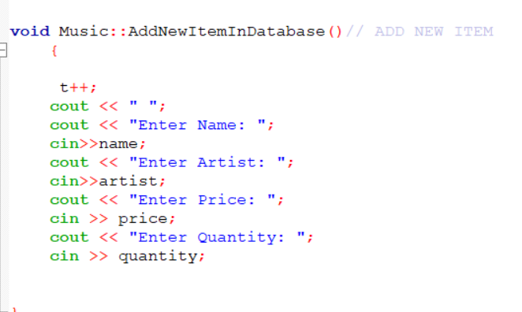
Functions of Music Class :
Add Item In Database
This function is used to add a new item in the database.
It adds four entries Name, Artist, Price & Quantity.

Slide 5
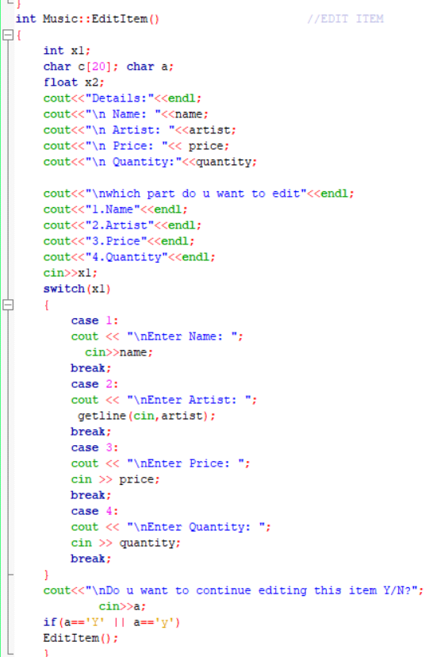
Edit item
This function is used to edit any entry of items.
This will First search the data to find the required item.
Then this will ask the user which entry to edit.

Slide 6
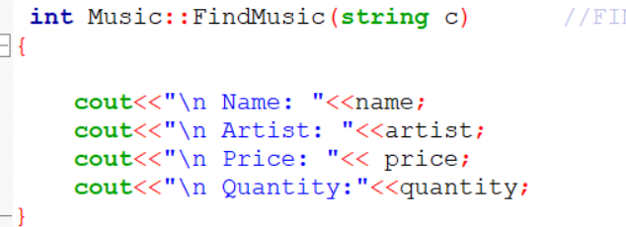
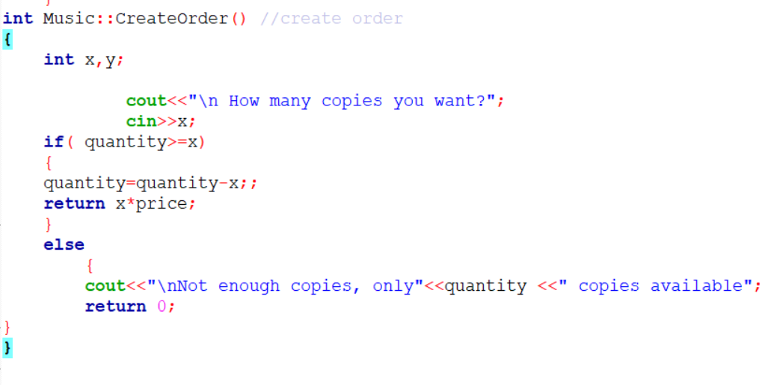
Find Music
This function is used to display all details of the song you are searching for.
Create Order
This function is used to Create Order of Music for customers.

Slide 7
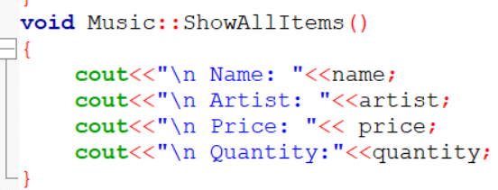
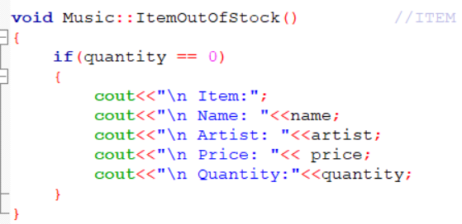
Show all Items
This function is used to display all items present in library.
Item Out Of Stock
This function is used to display all the items which are out of stock.

Slide 8
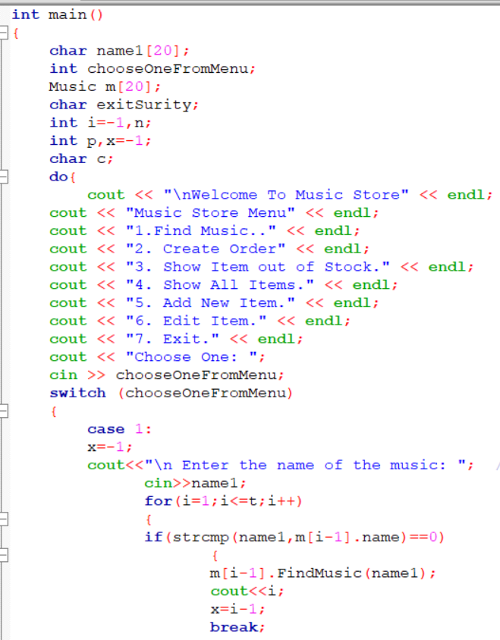
Main Function
This is the main function with switch cases calling for different functions.
This also contains some extra variables needed in the programme.

Slide 9
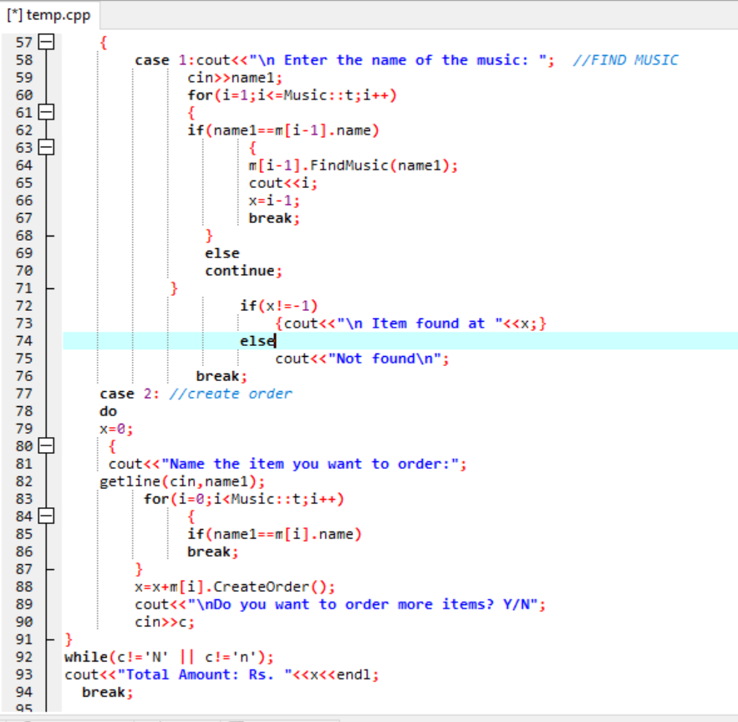
Case 1 is for finding an item.
It runs a loop and using operator overloading find the name string same as the one we want to find.
If the item is found it will output the details of that item.
Case 2 is for Creating an order
We can add as much items as we want.
It outputs the total amount of order.

Slide 10
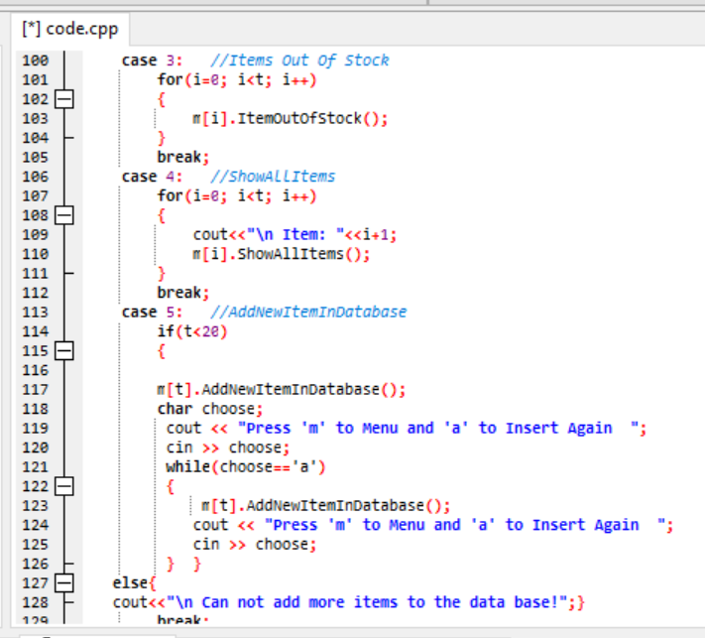
Case 3 is for showing the items which are out of stock so that we can order them .
Case 4 is for displaying all the details of the items present in library
Case 5 is for adding new items in the database.
It checks the memory available and accordingly fill the array of object.

Slide 11
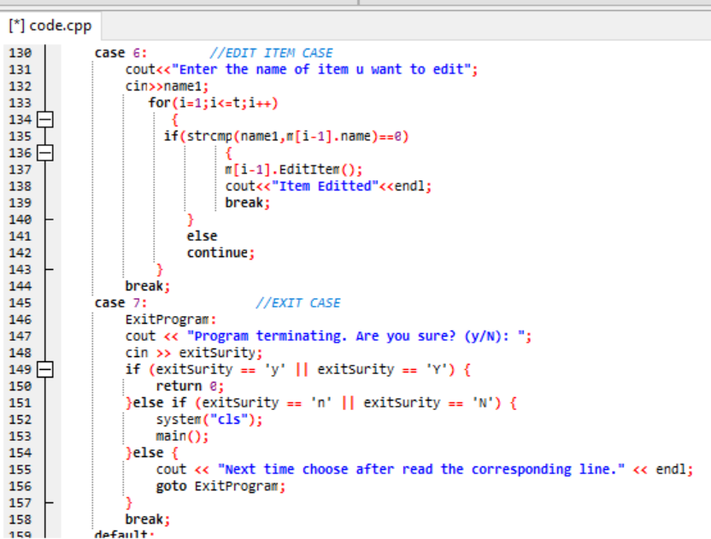
Case 6 is for editing items.
You can edit any variable in item.
Case 7 is for exiting programme.

Slide 12
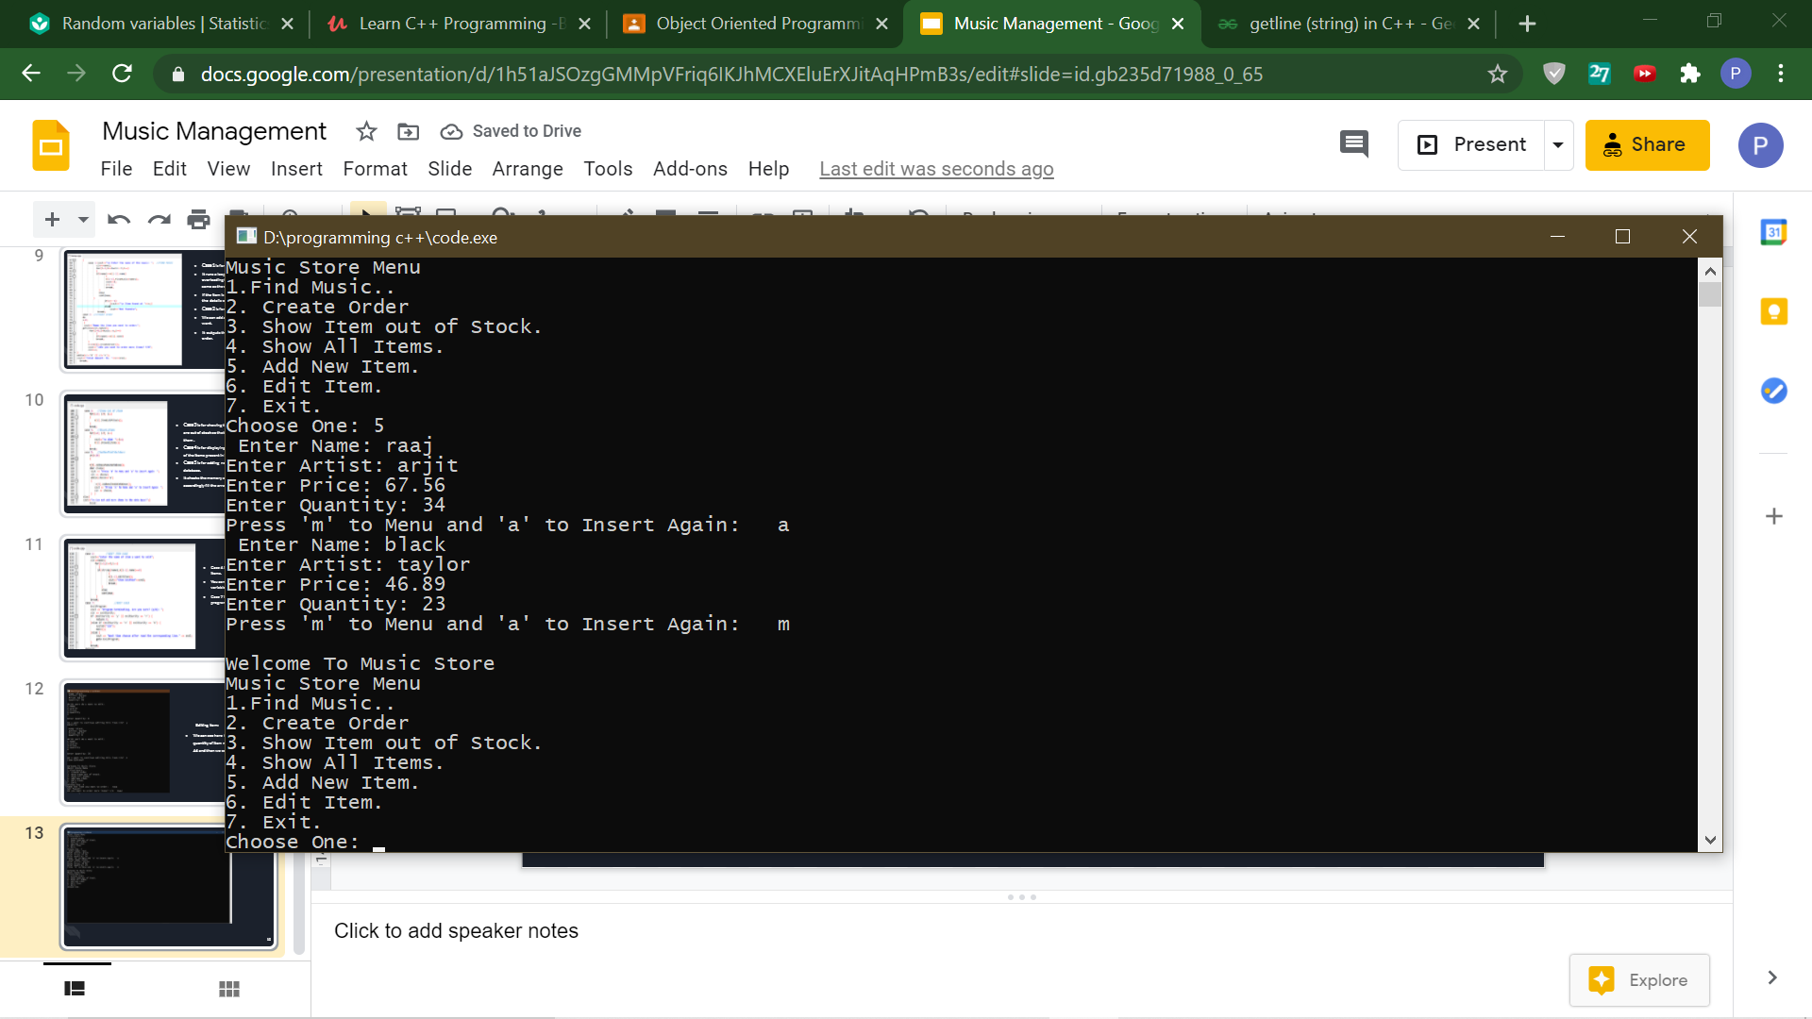
Add Item:-
We added two items in the library namely, raaj and black.

Slide 13
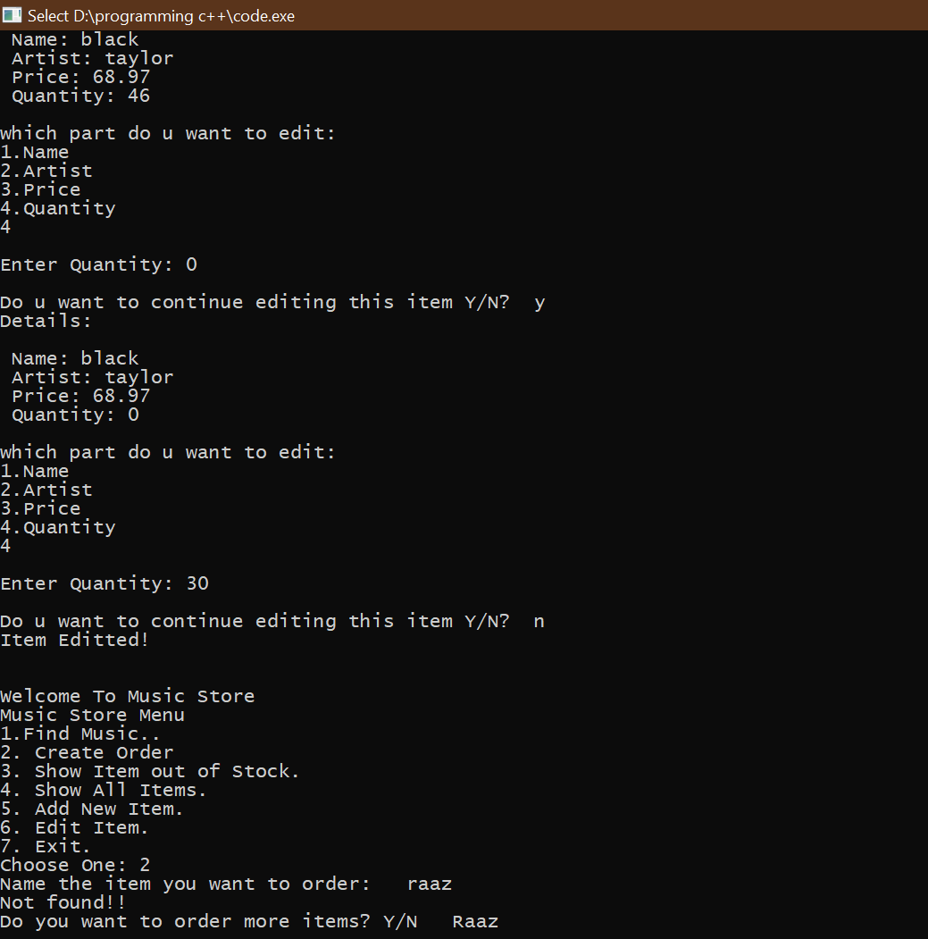
Editing Item:
We can see here that earlier the quantity of item name ‘black’ was 46 and then we edited it to 0.

Slide 14
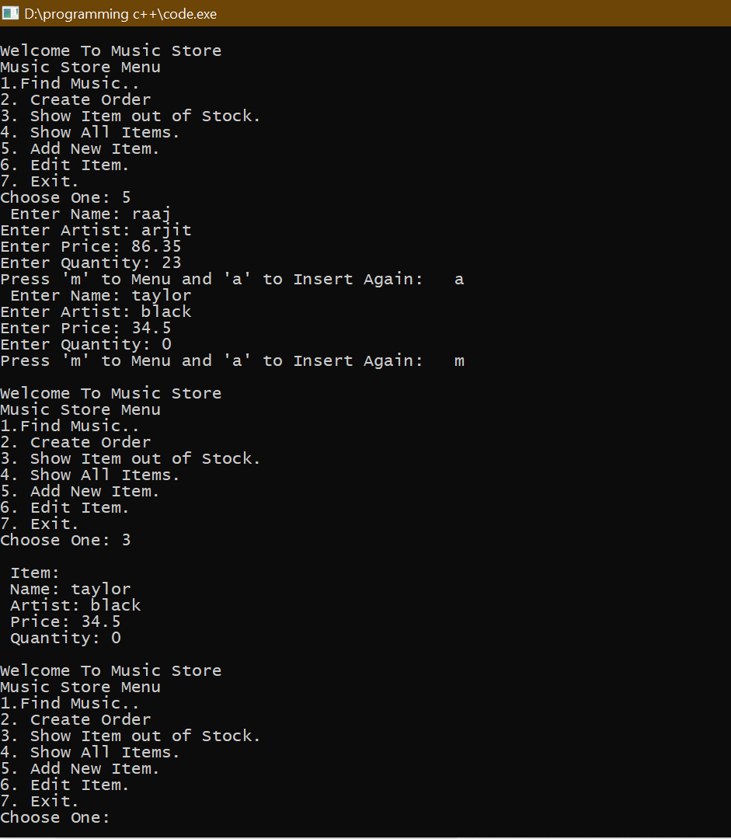
Showing Item Out of stock:-
It show the item details that are out of stock now.
In this it shows the item taylor as its quantity was 0.

Slide 15
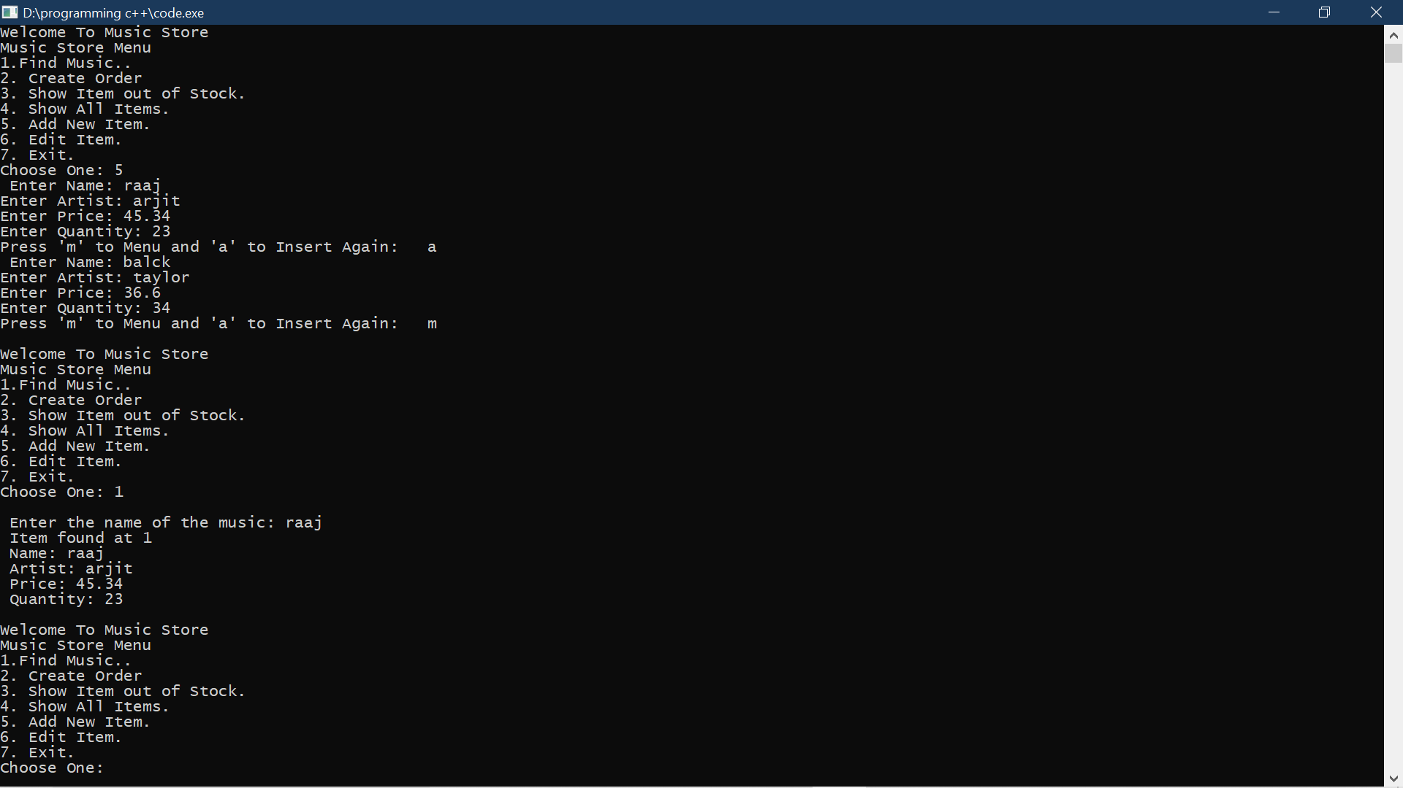
Find Music:-
We entered the item we wanted to search and it outputs the details of that item with the index no.

Slide 16
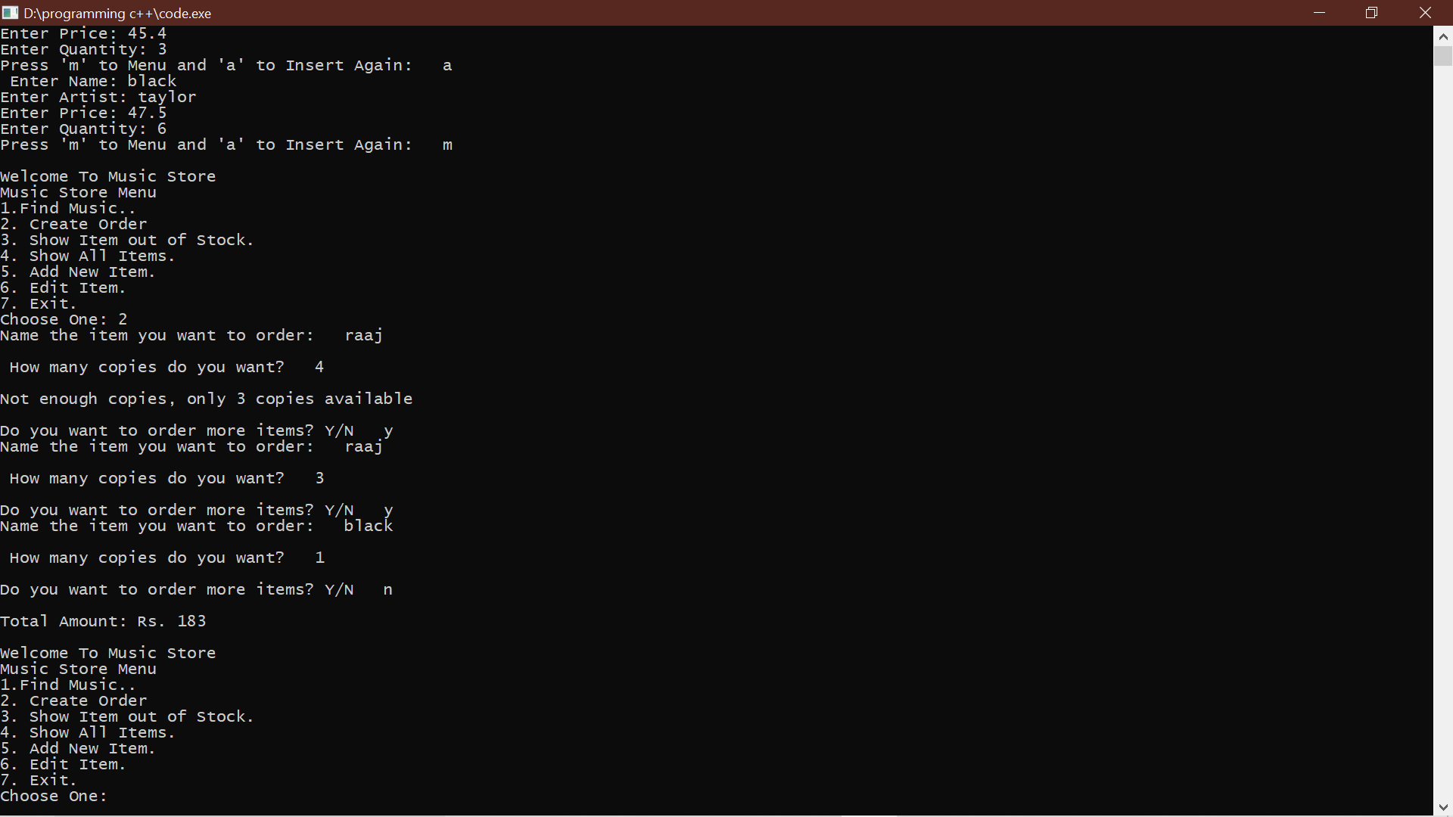
Create Order:-
We ordered the items we wanted to order and it gives the output total amount.

Slide 17
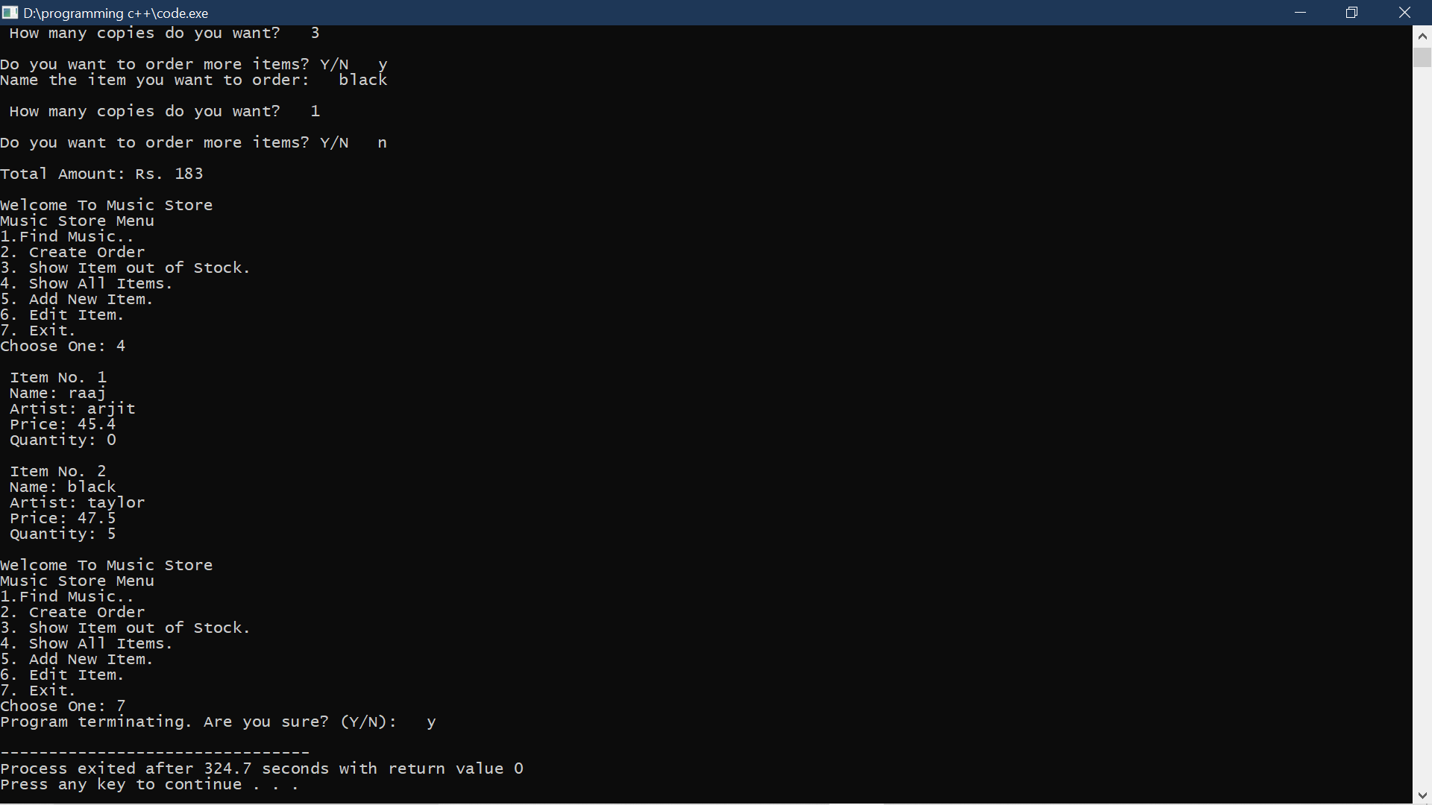
Show all Items:
It shows all the items present in the library.

Slide 18
Thank You

